Slide 1



GDG Hackathon – Introducing…
Marty van de Korput
IBM Technology
Country Technical Leader & CTO – Belgium & Luxemburg

Slide 2

We kind of like innovation…

Slide 3
IBM Research is the largest industrial research organization in the world.
Source: If applicable, describe source origin
17 labs across the globe
3,000 researchers
authored more than 110,000 research publications.
6 Nobel Prizes,
6 Turing Awards, and many more
150,000+ patents
Notes:
https://research.ibm.com/
IBM is fortunate to have had six employees who have won the Nobel Prize. They are:
Leo Esaki, Thomas J. Watson Research Center in Yorktown Heights, N.Y., in 1973, for work in semiconductors;
Gerd Bining, of the Zurich Research Center, in 1986, for the scanning tunneling microscope;
Heinrich Rohrer, of the Zurich Research Center, in 1986, for the scanning tunneling microscope;
Georg Bednorz and Alex Mueller, Zurich, in 1987, for research in superconductivity,
Alex Mueller, also of Zurich, in 1987, for research in superconductivity,
Harry Markowitz (with Merton H. Miller and William F. Sharpe), Thomas J. Watson Research Center in Yorktown Heights, N.Y., in 1990, for theories on evaluating stock-market risk and reward and on valuing corporate stocks and bonds.
Turing Award:
It is generally recognized as the highest distinction in the field of computer science and is often referred to as the "Nobel Prize of Computing".

Slide 4
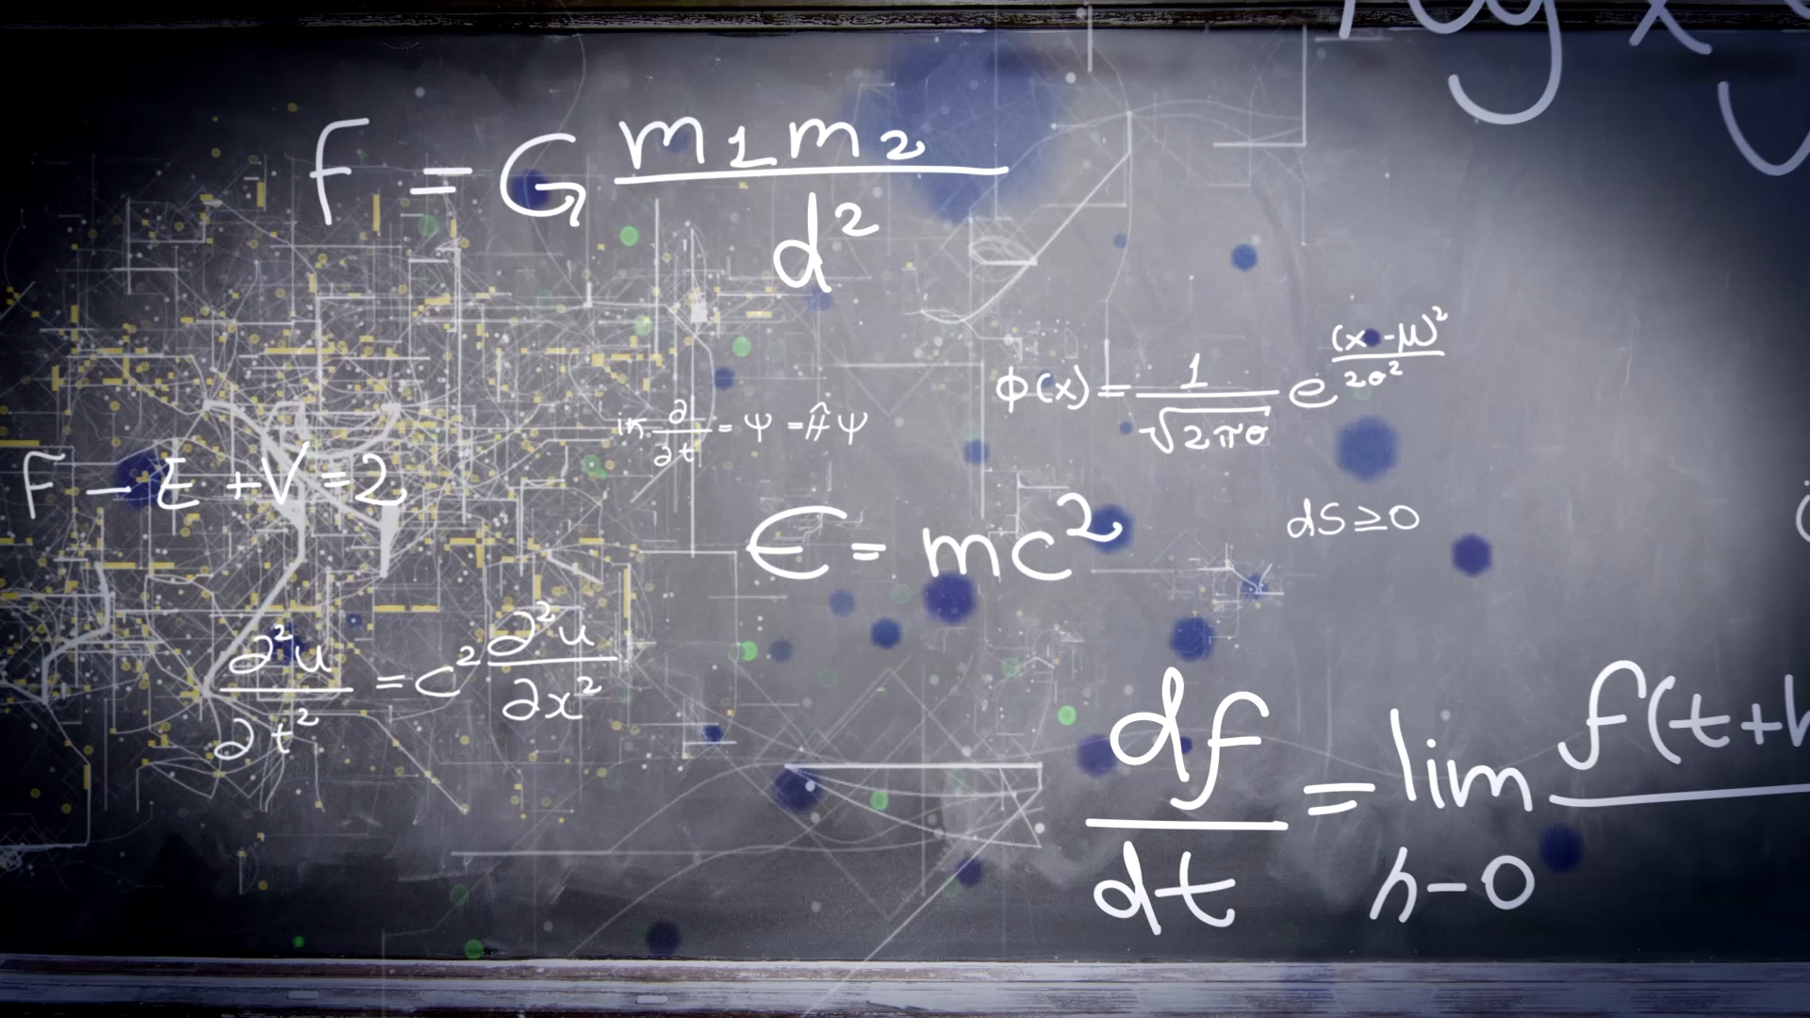
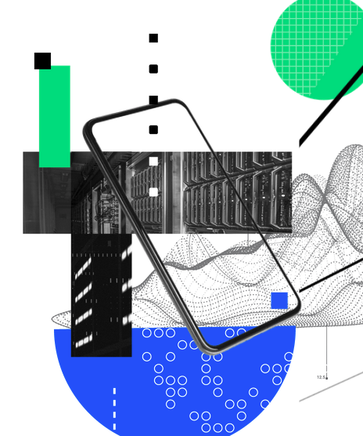
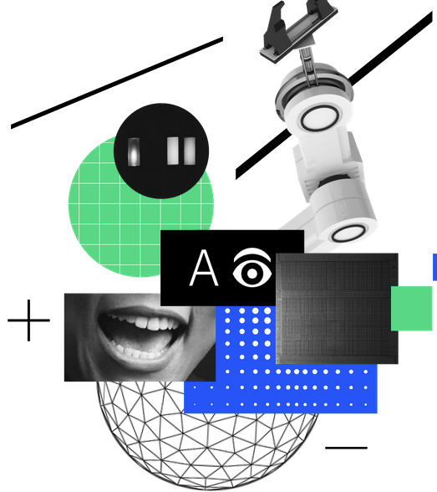
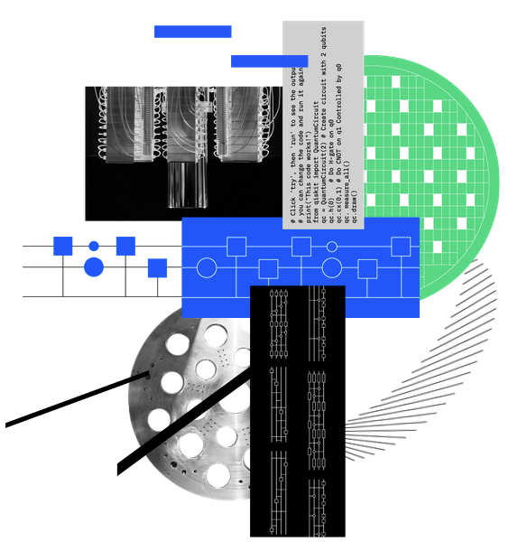
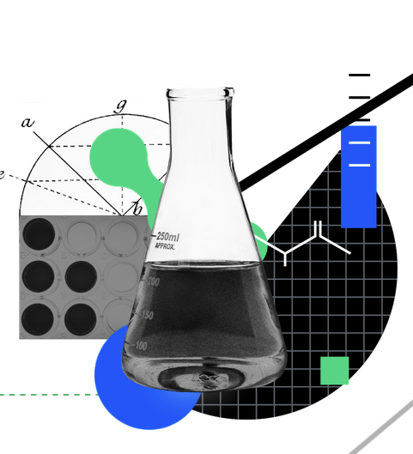
IBM Research Inventing what’s next in …
Hybrid Cloud
AI
Quantum
Science
Notes:
What’s next in
Hybrid Cloud is agility, secured
We’re driving open standards and open-source code to build a seamless hybrid cloud platform, weaving security, compliance, and reliability directly into the fabric of your hybrid cloud. We must increase agility while reducing risk through innovations across the entire stack.
in AI is fluid intelligence
Today’s AI is narrow. Applying trained models to new challenges requires an immense amount of new data training, and time. We need AI that combines different forms of knowledge, unpacks causal relationships, and learns new things on its own.
Quantum is frictionless development
We’re pioneering specialized hardware and building libraries of circuits to empower researchers, developers and businesses to tap into quantum as a service through the cloud, using their preferred coding language and without having to be quantum experts themselves. Science is accelerated discovery
Scientific discovery is driven by two forces: the development of new capabilities, and the relentless tenacity of the world’s sharpest minds. We see it as our duty to accelerate scientific progress by developing cutting-edge technologies, demonstrating scalable processes, and deploying new models of collaborative innovation.
IBM and NASA Release Open-Source AI Model on Hugging Face for Weather and Climate Applications

Slide 5
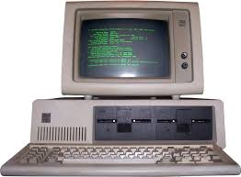
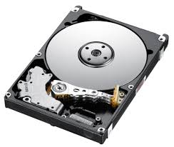
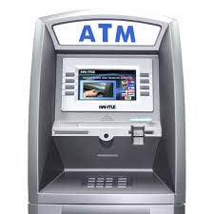



Did you that IBM invented…

Slide 6
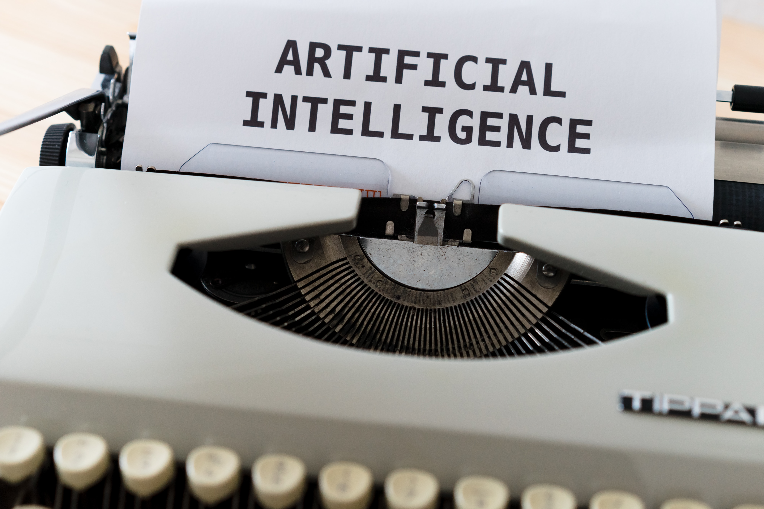
Notes:
ChatGPT created significant interest around the notion of large language models (LLMs). It’s great for consumer applications and there are some business applications it will help too, but the discussion should really be about what is the technology that's going to help businesses move forward.
And the hype is understandable as ChatGPT is easy consumable. It has a natural language interface, making it very easy for a user to interact with it.
Who used it already?
non-generative AI use cases - sentiment analysis, entity extraction, relationship detection, and classification, but require task-specific labeled data for fine tuning.
encoder-only large language models
AI generative use cases
A large language model (LLM) is a type of machine learning model that has been trained on large quantities of unlabeled text using self-supervised learning and can perform a variety of natural language processing (NLP) tasks (even when that language is a programming language). Output may range from books, articles, social media posts, online conversations, and even code. The architecture of an LLM consists of layers of neural networks that learn to generate language in a way that is similar to how humans use language

Slide 7
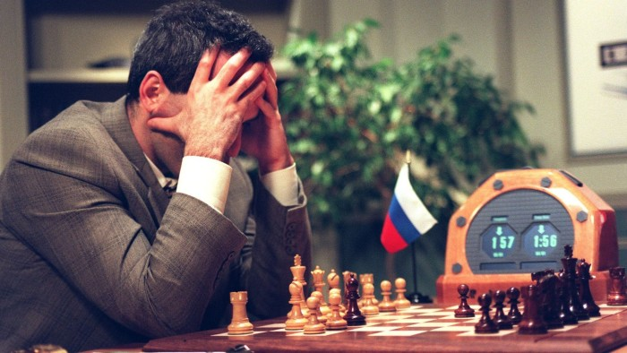

1997 – IBM Deep Blue beats Kasparov

Slide 8
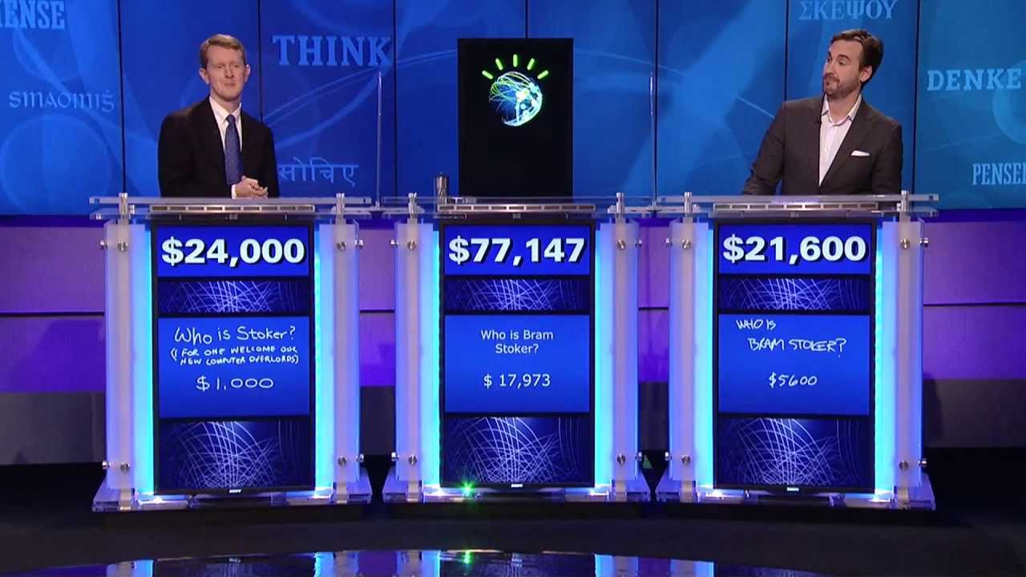
2011 – Jeopardy – IBM Watson beats the Champions

Slide 9

Today, more than 300,000 IBMers continue to help industries in 171 countries reinvent themselves.

Slide 10


Explore the open platform and connect with us for a demo at skillsbuild.org
IBM Corporate Social Responsibility / © 2023 IBM Corporation

Slide 11
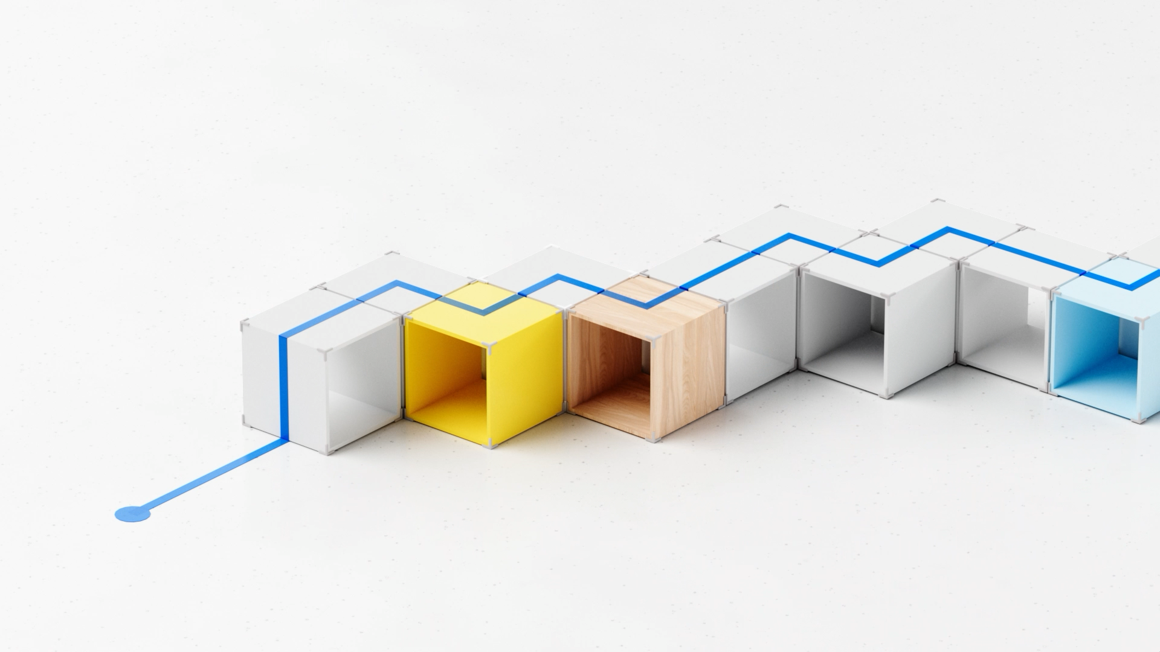













0123456789
0
1
0123456789
0
0123456789
0
Publications Office of the European Union
Concordance Checks
October 2025
proofreaders

Slide 12
0123456789
0
1
0123456789
0
0123456789
0
+
proofreaders
0123456789
0
0123456789
0
0123456789
0
0123456789
0
0123456789
0
0123456789
0
0123456789
0
+

Slide 13
0123456789
0
1
0123456789
0
0123456789
0
0123456789
0
0123456789
0
0123456789
0
0123456789
0
0123456789
0
0123456789
0
0123456789
0
+
proofreaders
24 x
pages of legal documents / year / language
+

Slide 14
Concordance Checks ↷
Examples:
Comparison of 2 language versions of the same text and detection of factual inaccuracies.
EN
Regulation (EU) 2022/947
LV
Regulas (ES) 2021/947
Regexps
(regular expressions) approach
TODAY:
Creating regular expression is complex and error prone.
EN
Article 31(4)
→
Difficult to maintain a large number of expressions (>900).
LV
31. panta 5. punkta
→
→
A lot of false hits (false positives).
A lot of hits are not detected (current approach doesn’t consider the context).
→

Slide 15
PILOT SCOPE
1
Experimentation
Concordance Checks
For the pilot, we focused on numbers and more specifically on:
1
Articles
4
Case references
2
5
Monetary amounts
Dates & times
3
Regulations
– directives and decisions
Reviewing - comparison and error detection -
of 3 language versions (English, German and Latvian) of the same legal documents in order to identify factual discrepancies and inconsistencies.
The concordance check should identify errors and should avoid:
False positives - incorrectly identifying an inconsistency (e.g. first vs 1)
False negatives – errors that are not identified.
The factual elements to compare should be identified irrespective of their placement in the sentence/paragraph.
The goal is to ensure that critical information is accurately reflected across all versions of a document, regardless of how it is presented in different languages.
+

Slide 16

What was done
+

Slide 17
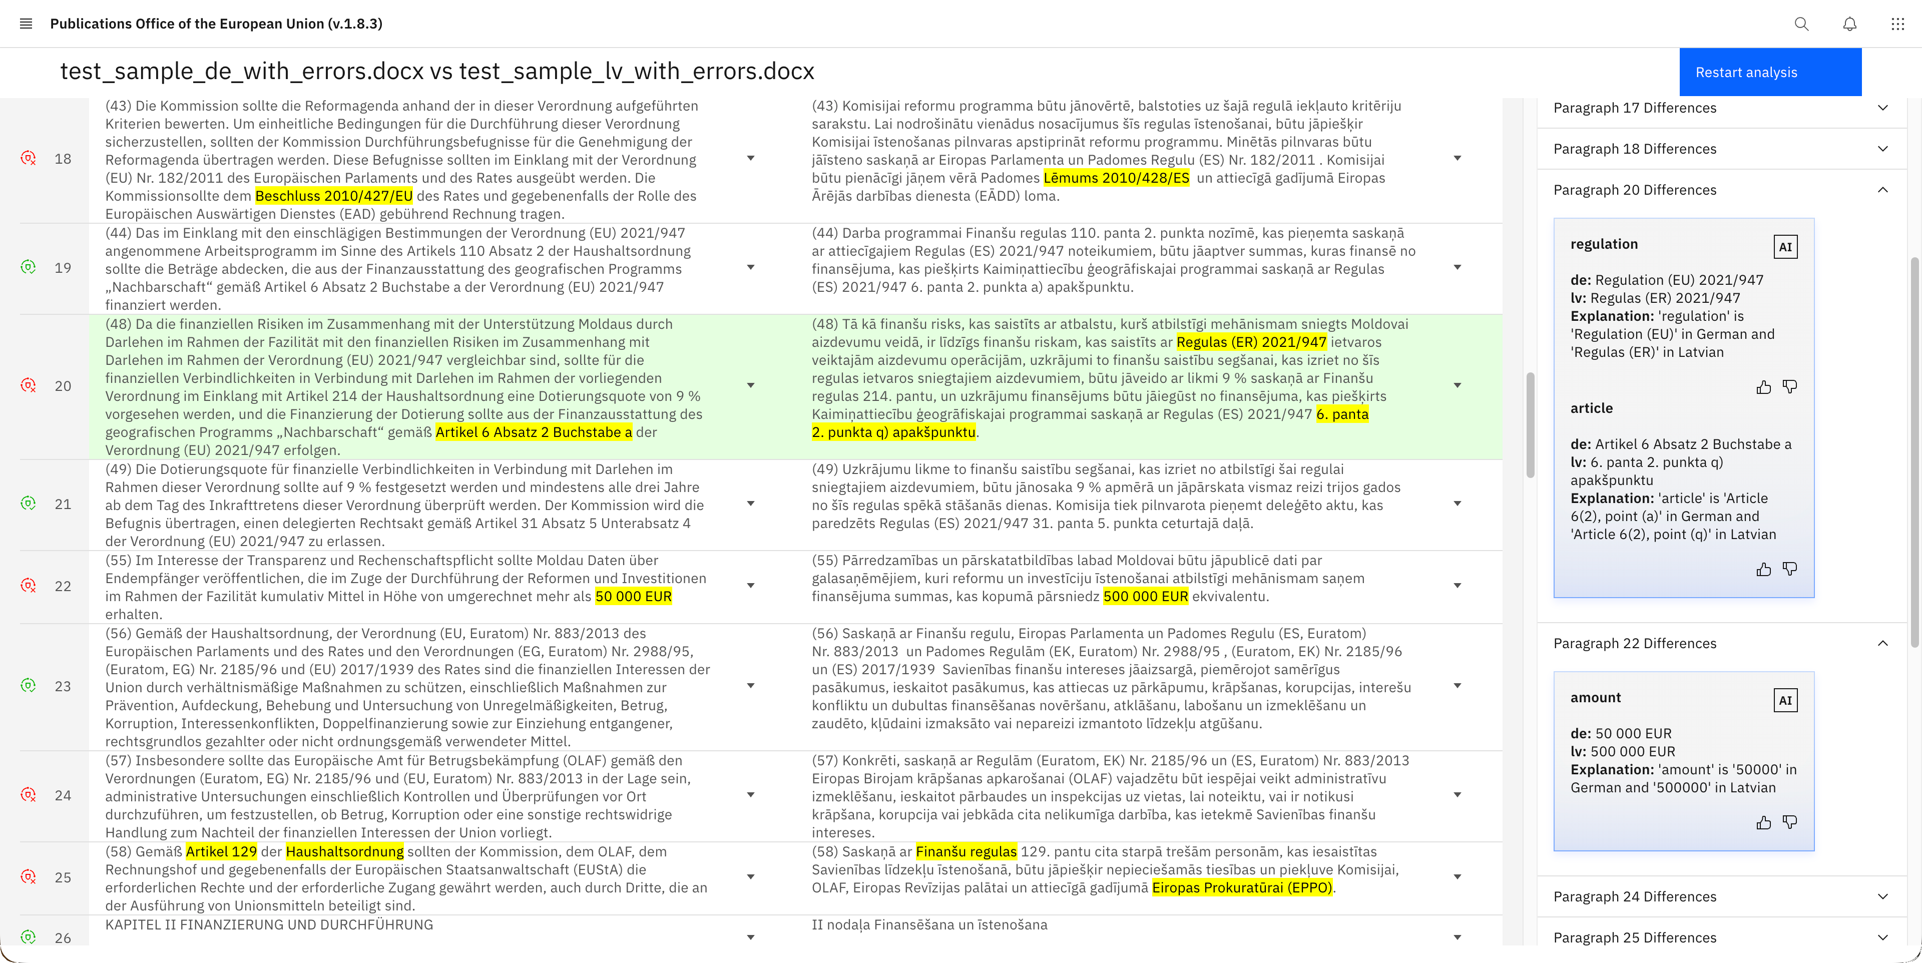

Slide 18
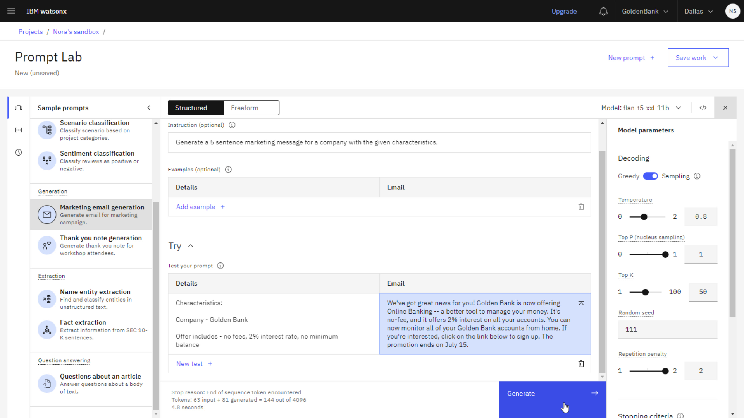
watsonx

Slide 19

Thank you!
+

